Slide 1

Integration Procedures
ROBIL Workshop
01/11/12
IAI

Slide 2
Contents
Integration Plan
Infrastructure
Highlights
Package Directory Structure
Additional needs
Process
Overview
Practical Steps
Summary
Open Issues
Introduction to QA methodology
Exercise with github for who wants

Slide 3
Integration Plan

Slide 4
Incremental Development
3 Stages of development and integration
Stage 1 – Basic Skills
Basic locomotion and stability (manual )
Get world image at some azimuth
Move arms along path to some target point
Plan & Execute combined actions, etc..
Stage 2 – Advanced Skills
Walk by path, detect and avoid obstacles
ingress\egress vehicle , drive by direct orders to the stirring wheel
recognize objects and hold them, etc..
Stage 3 – Full Event Skills
Perform full events incorporating cognitive skills and HMI interactions
Final bug fixes, testing and training

Slide 5
Timeline
Milestones | Nov-12 |  |  |  | Dec-12 |  |  |  | Jan-13 |  |  |  | Feb-13 |  |  |  | Mar-13 |  |  |  | Apr-13 |  |  |  | May-13 |  |  |  | Jun-13
Stage 1- Basic Skills
Stage 2- Advanced Skills
Stage 3- Full Event Skills
Final Gazebo version release
First Qualification Test (1-15/5)
Training on cloud environment (28/5-7/6)
Virtual Disaster Response (10-24/6)
Essential for integration:
Each Task should provide time schedule of development, i.e. what skills\capabilities will be provided every 2 weeks.
Please Do it by Nov 19th event.

Slide 6
Development Process
Module Requirements definition
According to DARPA’s requirements & Functional Analysis
Module development and testing (functionality and stability)
Local integration between components
Deliver:
Module version
Test scripts and results of test
Document
Test at IAI
Integration to software and testing
Release version

Slide 7
Integration Concept
C42
Test results
Test Environment
C34
C21
Test Environment
Test Environment

Slide 8
Infrastructure

Slide 9
Highlights
Version control: git
Software repository: www.github.com
Version reference via .ver file in each package
Directory structure according pre-defined format
Integration inside one package is out of scope of general integration of ROBIL

Slide 10
Package Directory Structure
userws4@darpaws4:~/git/robil/c51_carOperation$ ls -la
total 100
drwxr-xr-x 9 userws4 users 4096 Oct 29 08:14 .
drwxr-xr-x 5 userws4 users 4096 Oct 29 08:04 ..
drwxr-xr-x 2 userws4 users 4096 Oct 29 08:14 bin → generally generated
drwxr-xr-x 3 userws4 users 4096 Oct 29 08:14 build → generated
-rw-r--r-- 1 userws4 users 1644 Oct 22 15:01 cmake_install.cmake
-rwxr--r-- 1 userws4 users 1322 Oct 22 14:56 CMakeLists.txt
-rw-r--r-- 1 userws4 users 28501 Oct 24 11:33 .cproject →eclipse
-rwxr--r-- 1 userws4 users 120 Oct 25 15:05 mainpage.dox
-rwxr--r-- 1 userws4 users 41 Oct 22 14:56 Makefile
-rwxr--r-- 1 userws4 users 345 Oct 29 08:00 manifest.xml
drwxr-xr-x 2 userws4 users 4096 Oct 22 14:56 msg
drwxr-xr-x 4 userws4 users 4096 Oct 29 08:14 msg_gen →generated
-rw-r--r-- 1 userws4 users 4996 Oct 24 11:33 .project →eclipse
-rwxr--r-- 1 userws4 users 1538 Oct 24 11:33 .pydevproject →eclipse
drwxr-xr-x 3 userws4 users 4096 Oct 22 14:56 src
drwxr-xr-x 2 userws4 users 4096 Oct 22 14:56 srv
drwxr-xr-x 4 userws4 users 4096 Oct 29 08:14 srv_gen →generated
-rw-r--r-- 1 userws4 users 4 Oct 29 08:04 .ver →release management
-rw-r--r-- 1 userws4 users 4 Oct 29 08:04 Notes.txt →release management

Slide 11
Additional Needs (1)
Two files:
Version files:
One located under ROBIL and including the general version: V0.0.0.2 and the list of the packages with their respective version:
One per package including the version of the component itself: 0.1, 0.2, 0.3, 0.4, 0.5
V0.0.0.2
======================
C21_Vision_and_Lidar – 0.1
C51_carOperation – 0.2

Slide 12
Additional Needs (2)
Notes.txt:
Interfaces changed (if… then, should be clear)
How to check:
run test1, expected results: flashing green light and clapping hands
Known Bugs
Known Limitations

Slide 13
Process

Slide 14
Overview (1)
Package 1
Package #N
Package
#N+1
Deliver Package
Test environment, Scripts & Results, Documents
Test Package (IAI)
Increment Version files (.ver)
Local Development, Integration and Testing
INTEGRATION
Release Notes + Label Version
Tests Reported and Defect in Trac
According to predefined milestones
Release to QA
Defects in Trac

Slide 15
Overview(2)
GIT HUB
ROBIL
Official Tree
ro
PULL REQUEST
FORK
RemoteC21
CLONE/PULL
Local Git Repository
PUSH
Local C21

Slide 16
Overview(3)
New Version!!!
GIT HUB
ROBIL
Official Tree
ro
PULL REQUEST
FORK
RemoteC21
PUSH
PULL
CLONE/PULL
Local Git Repository
PUSH
Integrator Local
RemoteC21
Integrator
Local C21

Slide 17
Overview(4)
GIT HUB
ROBIL
Official Tree
ro
RemoteC51
FORK
RemoteC21
FORK
PULL
CLONE/PULL
CLONE/PULL
Local Git Repository
PUSH
Another location
Local C51
Local C21

Slide 18
Practical Steps (1)
In git hub:
Each participant should open an account.
Each team (per package) should fork the project in the github from the official tree.
GIT HUB
ROBIL
Official Tree
ro
RemoteTeam
FORK

Slide 19
Practical Steps (2)
At local site:
Each local computer: install git.
For ubuntu:
sudo apt-get install git-core (that’s it)
Strong Request: establish a reliable identity
git config --global user.name “Michele Hallak”
git config --global user.email “mhallak@xicore.net”
See online book:
http://git-scm.com/book/

Slide 20
Practical Steps (3)
At local site:
Create or fetch a convenient git repository:
Via eclipse or
>>git clone https://github.com/iops/robil.git
Add remote for push:
>>git remote add upload //github.com/TEAM/robil.git
If you want to check that it is properly configured:
>>cd robil
>>git remote –v
origin https://github.com/iosp/robil.git (fetch)
upload https://github.com/team/robil.git (fetch)
upload https://github.com/team/robil.git (push)

Slide 21
Practical Steps (4)
michele@ubuntu:~$ git clone https://github.com/iosp/robil.git robil
Cloning into 'robil'...
Username for 'https://github.com': mhallak
Password for 'https://mhallak@github.com':
remote: Counting objects: 96, done.
remote: Compressing objects: 100% (62/62), done.
remote: Total 96 (delta 32), reused 78 (delta 15)
Unpacking objects: 100% (96/96), done.
michele@ubuntu:~$ cd robil/
michele@ubuntu:~/robil$ ls
c21_Vision_and_Lidar c51_carOperation README.md
michele@ubuntu:~/robil$ git remote -v
origin https://github.com/iosp/robil.git (fetch)
origin https://github.com/iosp/robil.git (push)
michele@ubuntu:~/robil$ git remote add upload https://github.com/mhallak/robil.git
michele@ubuntu:~/robil$ git remote -v
origin https://github.com/iosp/robil.git (fetch)
origin https://github.com/iosp/robil.git (push)
upload https://github.com/mhallak/robil.git (fetch)
upload https://github.com/mhallak/robil.git (push)
michele@ubuntu:~/robil$

Slide 22
Practical Steps (5)
Developing Team
Work Locally
Develop
Pull from Origin
Merge locally with the official repository
Push & Pull Request
Push to your hub repository
Integrate
Test
Test
Update Notes.txt
Send pull request

Slide 23
Practical Steps (6)
Integrator
Pull Request
Is there comprehensive documentation?
Do we know how to check the new version of this package?
Pull Locally
Test
Integrate
Push to official Tree
Watchers (on github) are alerted
Nice email might be sent if necessary
Increment .ver files

Slide 24
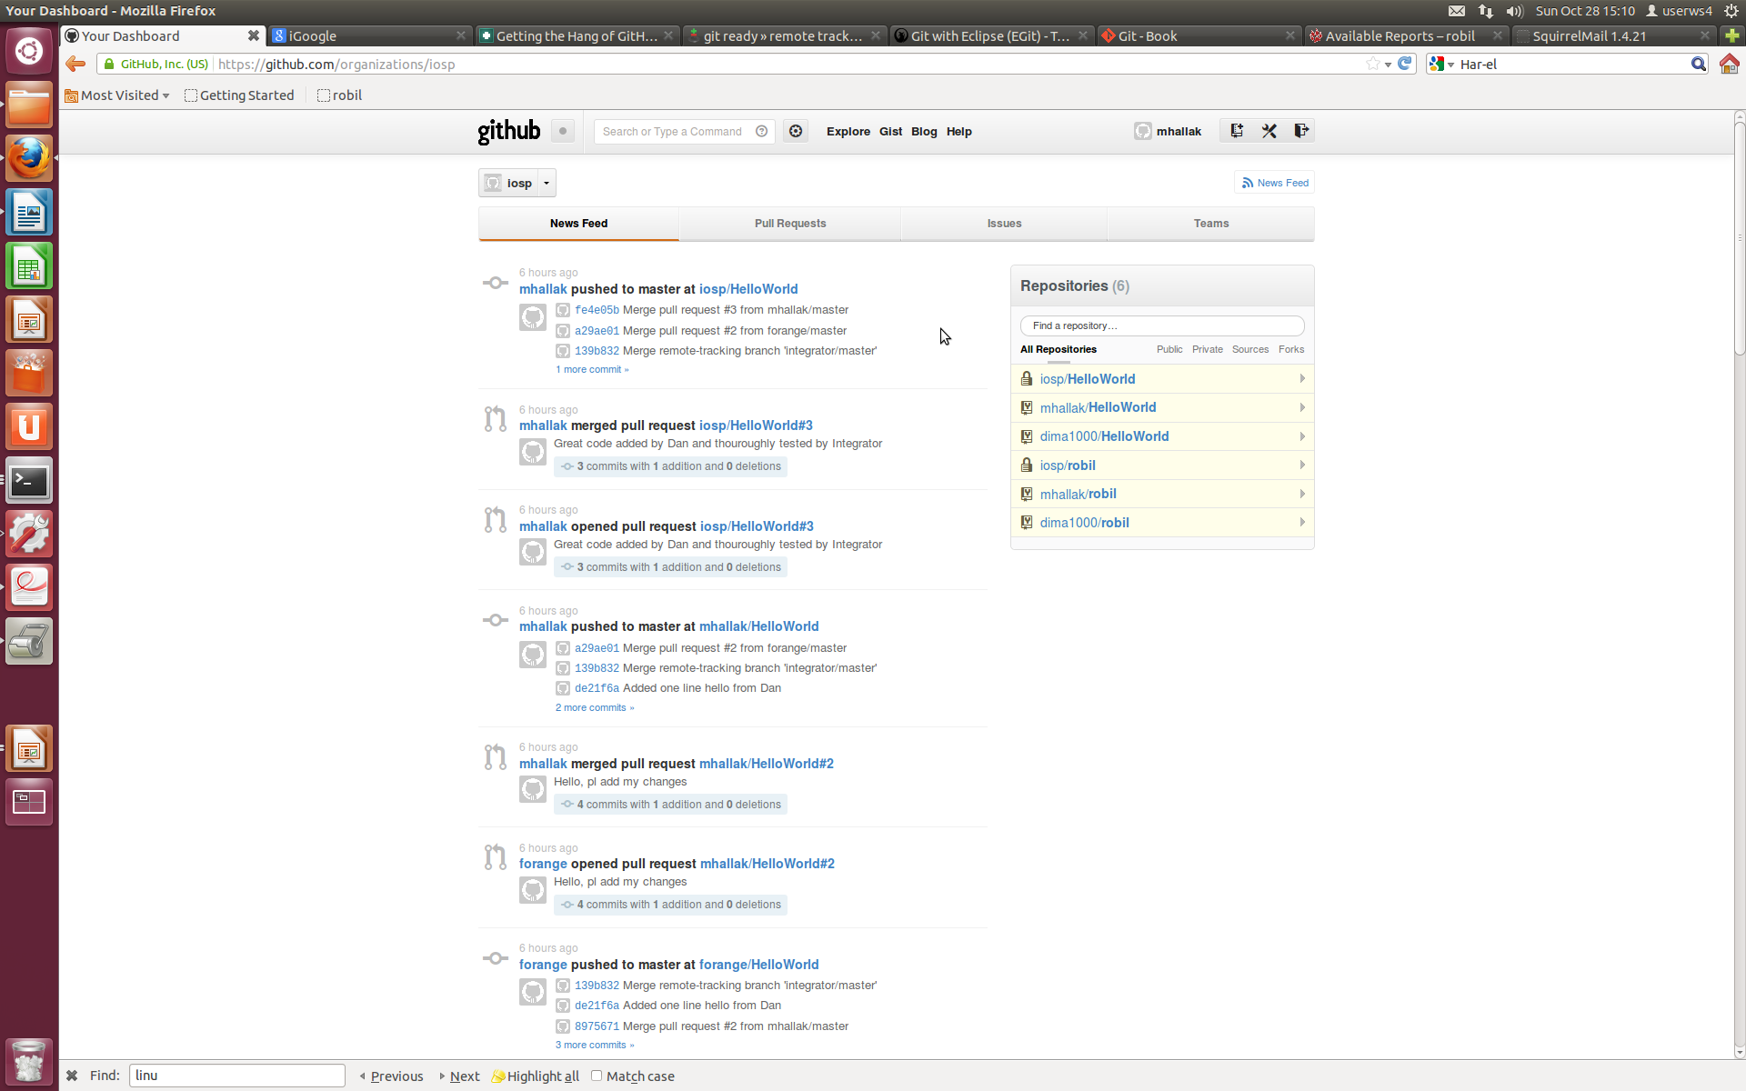
github Wall

Slide 25
Summary: Team Responsibility
Assign one point of contact per package
Each user must have a reliable identity in git as well as in github
Provide tests scripts and environment
Update specific release file: Notes.txt
Pull most updated version before pushing
Be responsive, patient and available on the phone/skype until “pull request” is closed.

Slide 26
Summary: Integrator Responsibility
Check code thoroughly
Update (version) files: .ver
Push to tree
Make sure that the “What’s new?” of the new version is clear.

Slide 27
Open Issues
Detailed Integration Plan
Dealing with Gazebo updates

Slide 28
Introduction to QA methodology
Each version that goes to QA will get a label (branch) of the official tree
We will work with track
http://www.robil.org:8000/trac_robil/wiki

Slide 29
Exercise
On Github: www.github.com: Fork one repository HelloWorld
On your own computer
Install git if needed:
>sudo apt-get install git-core (that’s it)
Clone repository "HelloWorld"
>git clone <URL> <local_name>
>cd HelloWorld
>git remote add upload <url>

Slide 30
Exercise (cont.)
Edit file (HelloWorld.c) and add "Hello <Your Name>"
Add to index: >git add HelloWorld.c
Commit: >git commit -m "My First Commit!!"
Pull most updated version:
>git pull origin master
Resolve conflict (if there is)
Push to upload:
>git push upload master
Check that your github is updated
Send a pull request (git hub)

Slide 31
THANK YOU!!!
SkypeID, YahooID, GmailID: → mhallakstamler
mhallakstamler@gmail.com
Looking forward to see you online!

Slide 32
Add module to Robil
Enter eclipse
Add new project like "c23 - perception"
Select Team/Share? project and select Git and then drop down repositories list and select robil
add .gitignore for C++ and */bin/* and *~
add README.md
git add --all
git commit -m "first commit"
git remote add origin https://github.com/<username>/<projname>.git
git push -u origin master

Slide 33
Recommendations
Clean the project before deliver to git (?!)
The project folder should appear only once to prevent problems with rospack
How to change user name and email in git local repository
git config --global user.email <email>
git config --global user.name <username>
How to remove changed files from index
git rm --cached <file name>

